Slide 1

Classification of bow shock and magnetopause event positions by using the Magnetic Field properties of Saturn
MATHEWS PHILIP VENATTU
MSc in DATA SCIENCE AND ANALYTICS
STUDENT ID: 20250487
Dr. KATARINA DOMIJAN
ASST.PROFESSOR
MATHEMATICS AND STATISTICS DEPARTMENT
MAYNOOTH UNIVERSITY

Slide 2
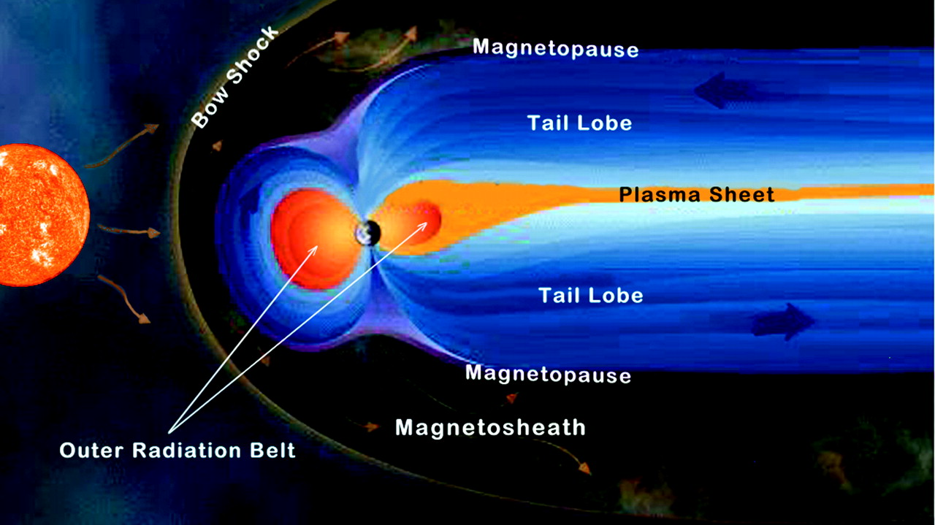
Problem statement
To classify the different boundary crossings of CASSINI Spacecraft by using the Magnetic field properties of Saturn.
By classifying the boundary crossings it will give more insights to the Solar wind conditions of Saturn at the time of crossing.
Notes:
Cassini-Huygens mission was initiated to study the planet Saturn and its system(natural satellite)
Bow Shock Occurs when magnetosphere of astrophysical objects interacts with the flowing plasma like solar wind when the speed or pressure of the wind decreases suddenly.
Magnetopause is the boundary between the planet's magnetic field and the solar wind.

Slide 3
Data used
Full_Cassini_Master_MP_BS_CMJ_revised2005
It contains list of BS and MP Points at Saturn for the year 2005.
Important Features:
Type of cross: BS, MP, DG and SCAS
Direction of cross: I ,O ,S_SW , E_SW, S_SH, E_SH, S_SP, E_SP
Cassini Magnetometer Dataset
It contains the Cassini magnetometer data for 2005.
Important Features:
Positions of Spacecraft: X_KSM,Y_KSM , Z_KSM
Magnetic Field vector data : Bx, By , Bz and Btot (all in KSM coordinate system).
Notes:
Kronocentric Solar Magnetospheric(KSM)
KSM is a cartesian Saturn-center coordinate system where X points from Saturn to the Sun, the X-Z plane contains Saturn's centered magnetic dipole axis, M, and Y completes right handed set.

Slide 4
Data manipulation
Merged the two datasets :
Used Timestamp of both the datasets as the key value for joining.
To identify the Magnetometer readings during different events.
Dimension of data after joining (49452,18)
Imputed all the NA values in type_cross variable as NE (No Events)
Imputed all the NA values in dirn_type variable as UD (Unknown Direction)
Made the data wider
Created columns which contains information of Magnetic field strength of 15 data points before and after an event.
Dimension of data (49452,219)
Removed all the rows with type_cross=“DG” and type_cross=“SC”

Slide 5
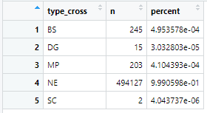
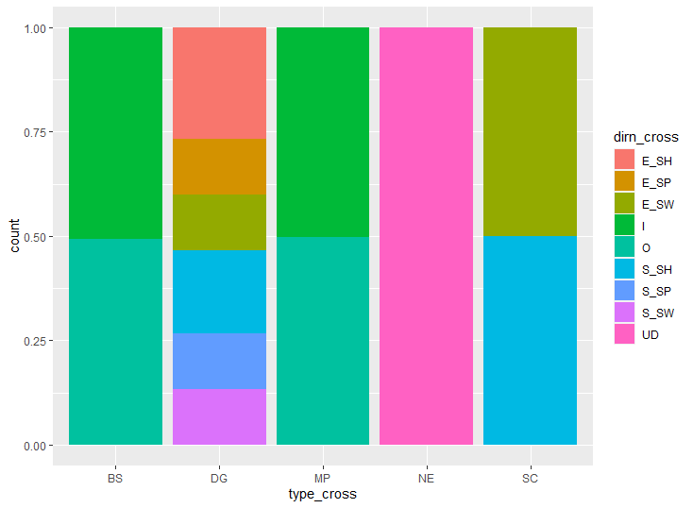
Data Visualization
From Fig 1(a)
Most of the datapoints are in the category of No Events Occurred
From Fig 1(b)
Directions are unknown for the Cross Type of NE.
There are equal number of Inbound and Outbound direction datapoints for the Bow Shock and Magneto Pause events.
Fig 1(a) :Total Counts of Events in Data
Fig 1(b) :Proportion of different directions Events in Data

Slide 6
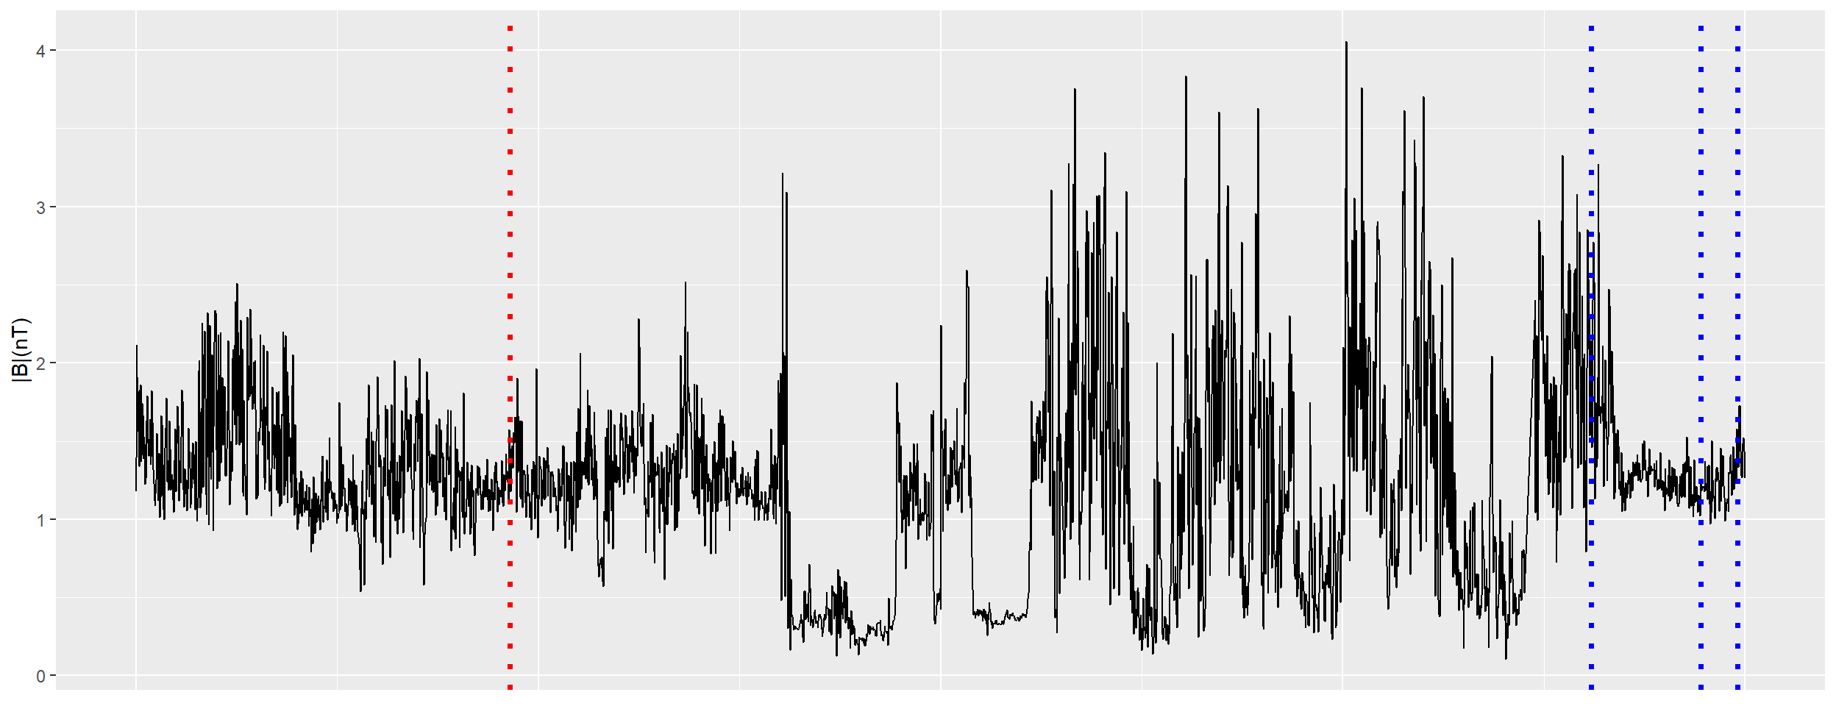
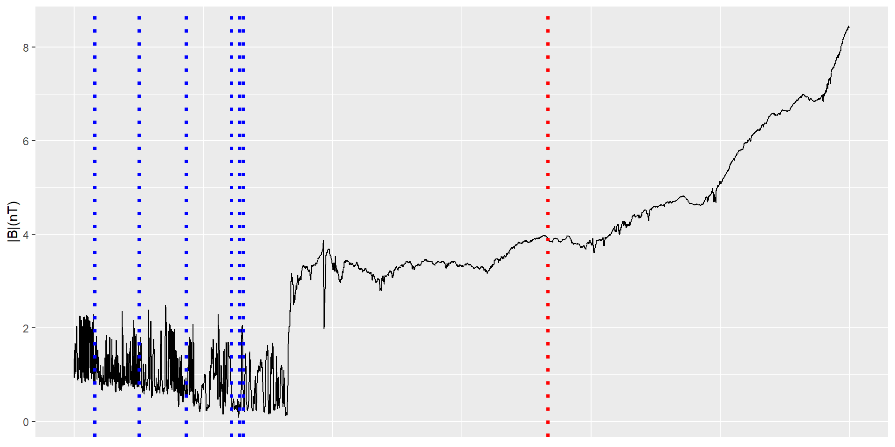
Data visualization
- In both the fig 2(a) and (b)
- Recorded Between the days 72 and 74 ---of the year 2005(Outbound)
- Recorded Between the days 136 and sss138 of the year 2005(Inbound)
- Blue dotted Line: Bow Shock Events
- Red dotted line : Magnetopause events
- Fig 2(a) : The points are recorded when Cassini Spacecraft was in Outbound
-Fig 2(b): The Points are recorded when Cassini Spacecraft is in Inbound
Fig 2(a): Btot vs Timestamp [Outbound]
Fig 2(b): Btot vs Timestamp [Inbound]

Slide 7
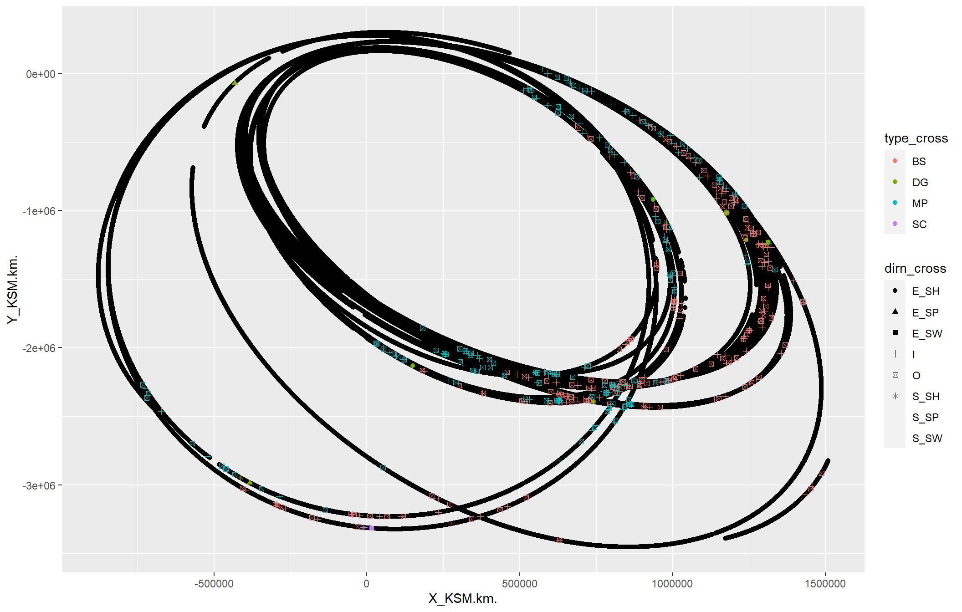
Trajectory of Cassini Spacecraft
KSM Coordinate System was used.
Most of the BS events are occurred in the area where both X and Y are very high.
MP events occurred in the tail of BS events
Fig 3: Trajectory of Spacecraft

Slide 8
Classification models used
For classification two datasets were used which was derived from the main dataset
Training Dataset: A dataset which contains the 100 data points of each events.
Test Dataset: All remaining data points
Above method is used to make the data balanced for training.
Models used
Logistic Regression
Trying to classify two categories:
Bow Shock Events (1) and Remaining events (0)
Magneto Pause Events (1) and Remaining Events (0)
Random Forrest
Trying to classify all the categories (BS,MP and NE)

Slide 9
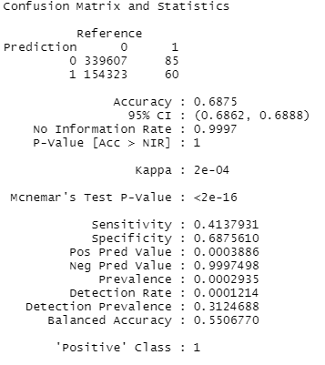
Logistic regression model-1
In this Model we are trying to predict
BS points which is recorded as ‘1’ in the column event_recorded
MP and NE points are recorded as ‘0’ in the column event_recorded
Accuracy is about 69%
60/145 Bow shock points were predicted correctly.
The threshold used here is 0.9
Fig 5: Confusion Matrix of Logistic Regression Model-1

Slide 10
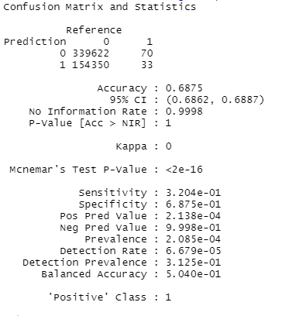
Logistic regression model-2
In this Model we are trying to predict
MP points which is recorded as ‘1’ in the column ‘event_recorded’
BS and NE points are recorded as ‘0’ in the column ‘event_recorded’
Accuracy is about 69%
33/103 Magnetopause points were predicted correctly.
The threshold used here is 0.9
Fig 6: Confusion Matrix of Logistic Regression Model-2

Slide 11
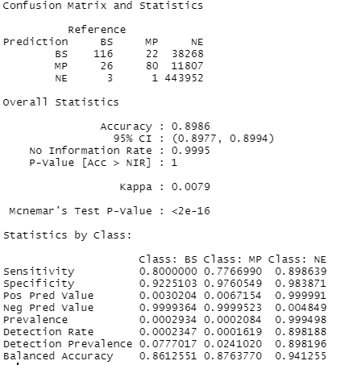
Random Forest
- Trained using the balanced dataset
- Tested Using all the remaining Datapoints
- Used the ‘ranger’ package
- Accuracy is about 90%
- 116/145 BS events are classified correctly
- 80/106 MP events are classified Correctly
Fig 4: Confusion Matrix of Random Forrest Model
Notes:
Add Epochs Count

Slide 12
Conclusion
The dataset contains a highly imbalanced data
Logistic regression model summary shown that all predictors are significant
BS events were predicted accurately than the MP events in Logistic regression Models
Random Forest model with the balanced data configuration has performed better

Slide 13
Further work
Classifying the events in dataset by using Neural Networks.
Classifying the regions at which bow shock and magneto pause separate.

Slide 14
THANK YOU

